Slide 1
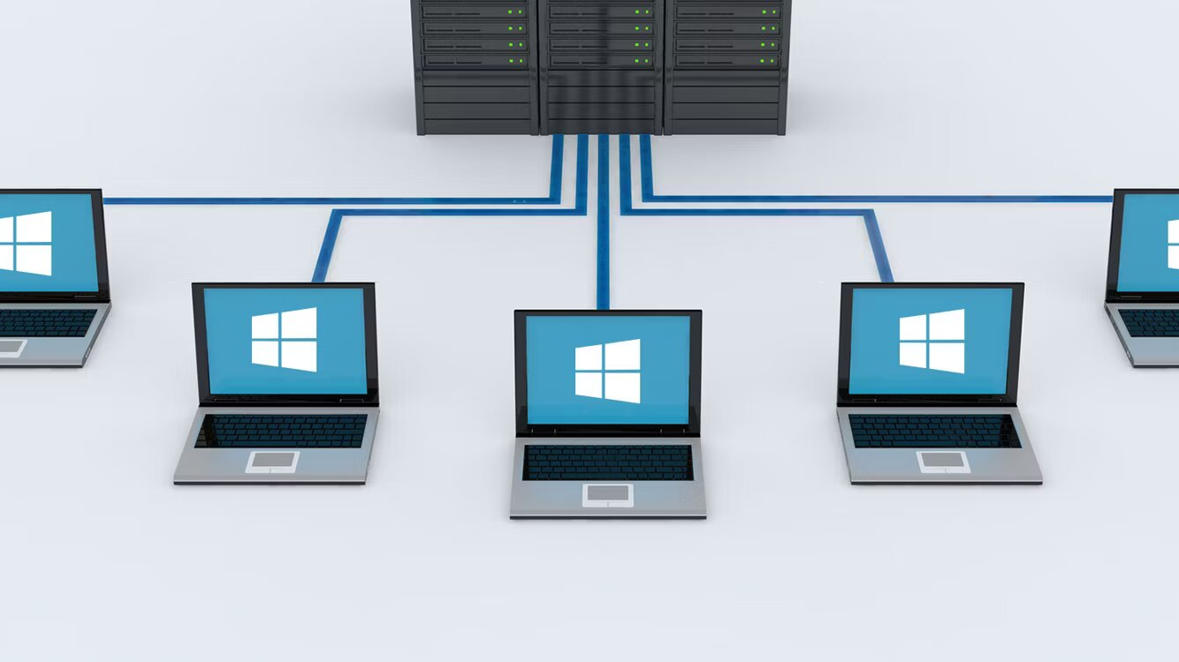
What is the domain ??

Slide 2
Introduction
A domain contains a group of computers that can be accessed and administered with a common set of rules.

Slide 3
A windows domain is essentially a network of controlled computers used in a business setting. The network administrators require a server to control all the other devices that is domain controller. ADVANTAGES The biggest advantage of domains is ease of controlling many computers at once. Without a domain, IT staff would have to individually manage each computer in a company. DISADVANTAGE For a single user it is very tough to understand the complex structure of domain controller.

